Slide 1

Case Study- Open Library Data
Senior Data Engineer-M3
Neeraj Raghav

Slide 2
Understanding Case Study: Open Library
Open Library is an initiative of Internet Archive, building a digital library of internet sites and other cultural artifacts in digital form.
They provide public feeds with the library data.
Requirement Details:
Get the dataset from the open library site
Familiarize with dataset- exploratory data analysis
Cleaning of data
Get the book with the most pages
Find the top 5 genres with most books
Retrieve the top 5 authors who (co-)authored the most books
Per publish year, get the number of authors that published at least one book
Find the number of authors and number of books published per month for years between 1950 and 1970

Slide 3


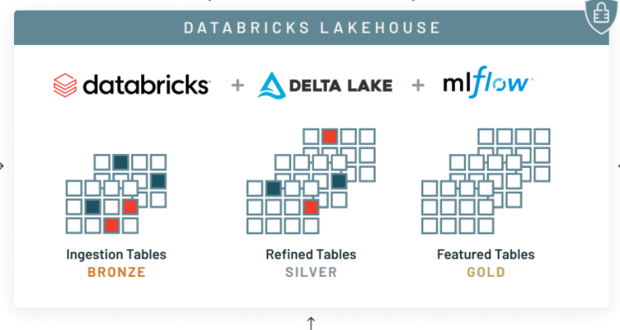





Solution Framework Architecture
AWS
Storage- AWS S3
Data Warehouse
Open Library Site
Reports
STG
Trans
PUB
Pipeline Orchestration & Monitoring- Airflow

Slide 4
Tools & Cloud Services used
Framework, Tools and Language used:
Spark
PySpark
PyCharm
AWS IAM
DataBricks
Delta Lake
Amazon S3
Airflow
Redshift
Quicksight

Slide 5
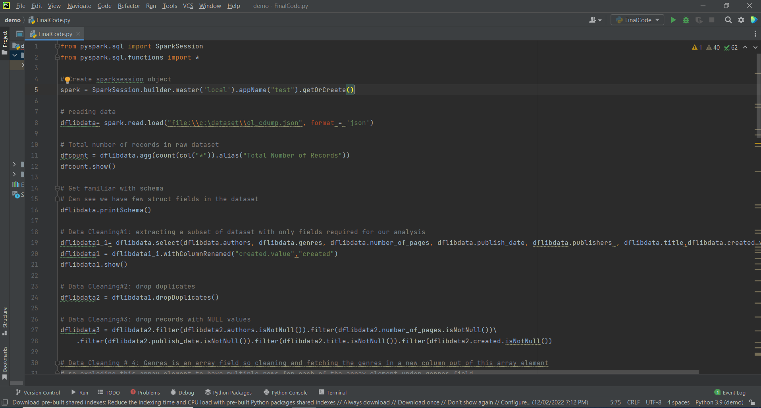
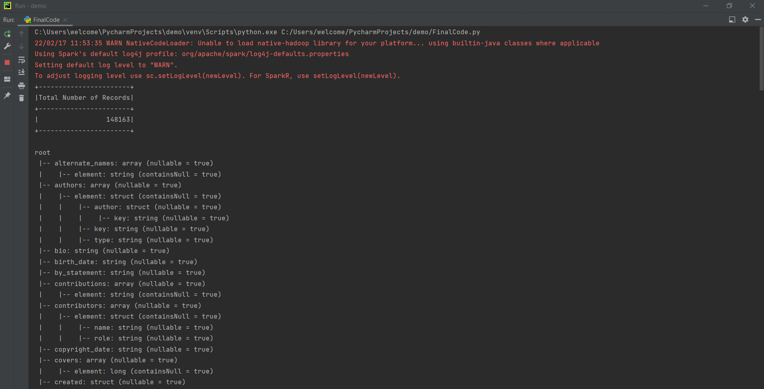
Data Discovery & Exploratory Data Analysis
SPARK development environment
PyCharm IDE used for initial data analysis
PyCharm using SPARK compute engine and language PySpark

Slide 6
Solution Implementation- Cloud Environment Setup
AWS Cloud for implementing this solution
Amazon S3 bucket for Storage.
IAM user for mounting Amazon S3 storage bucket on DataBricks
DataBricks workspace mounted on AWS EC2 instance.
DataBricks cluster
Airflow for data pipeline orchestration

Slide 7
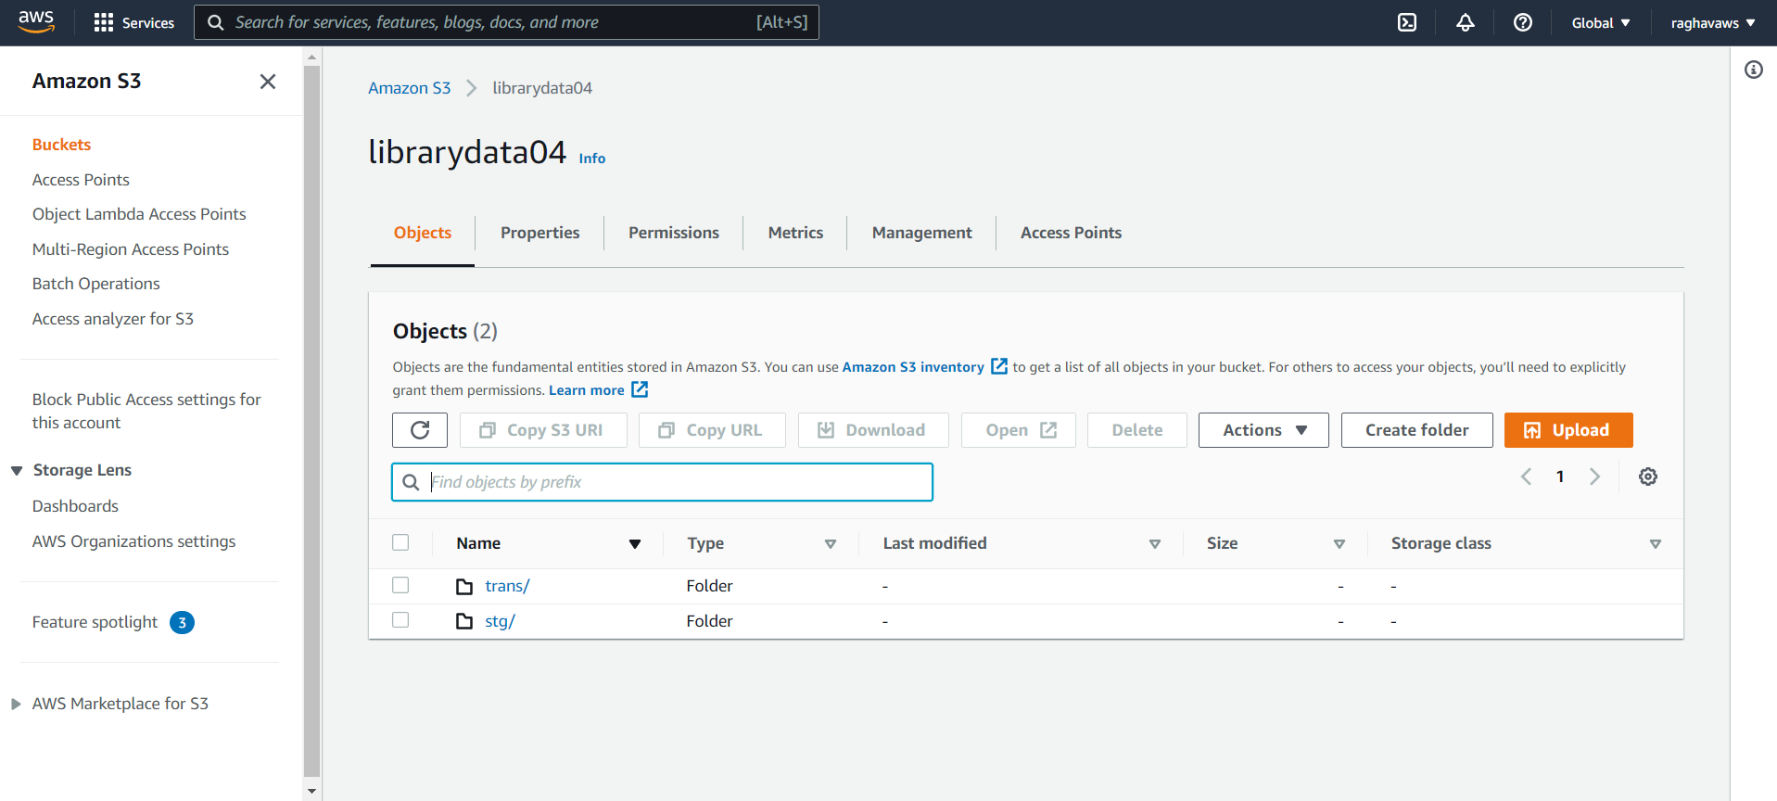
AWS Environment Setup- S3 bucket
AWS IAM user: Airflow:

Slide 8
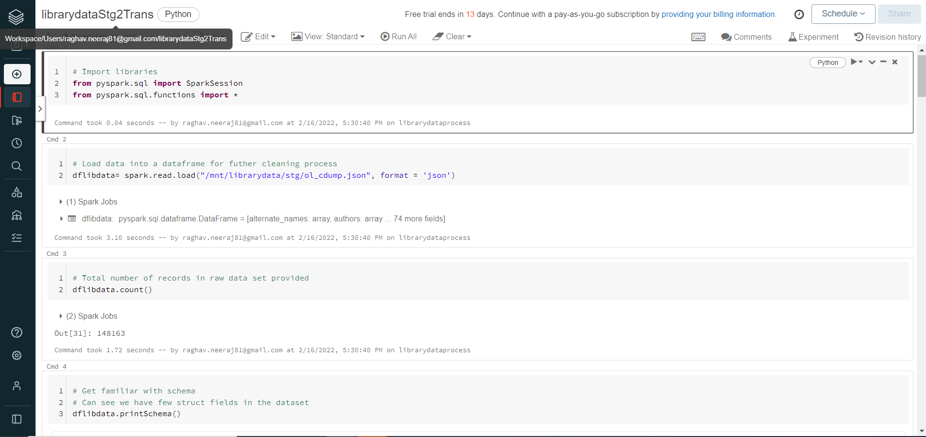
AWS Environment Setup- DataBricks Workspace

Slide 9
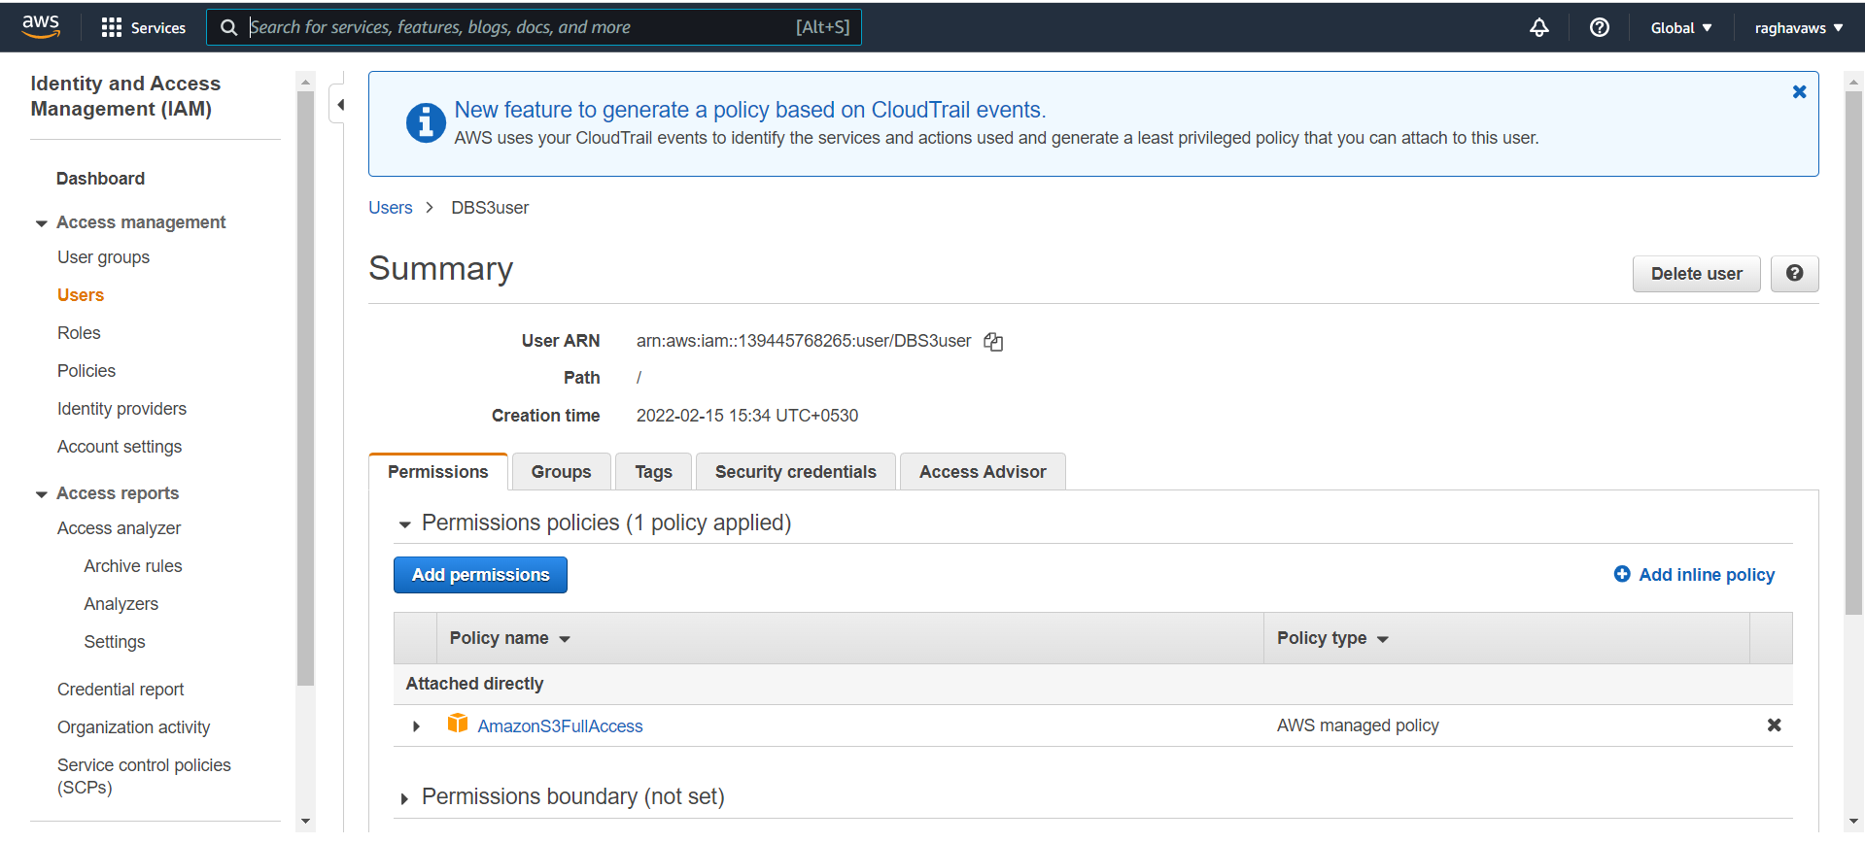
AWS Environment Setup- IAM user

Slide 10
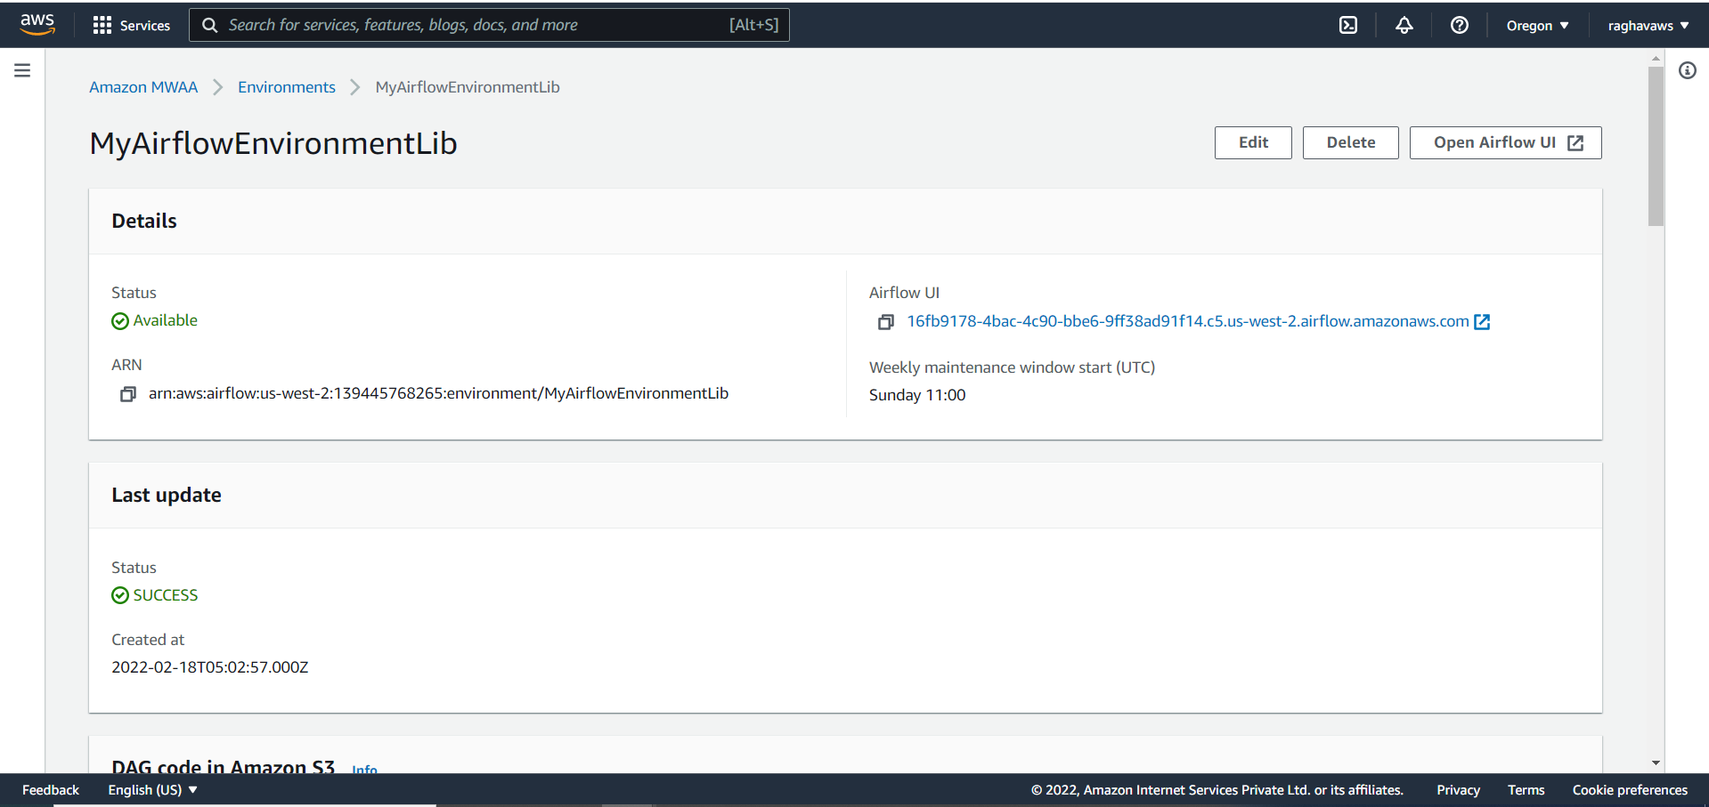
AWS Environment Setup- Airflow Workspace

Slide 11
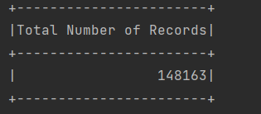
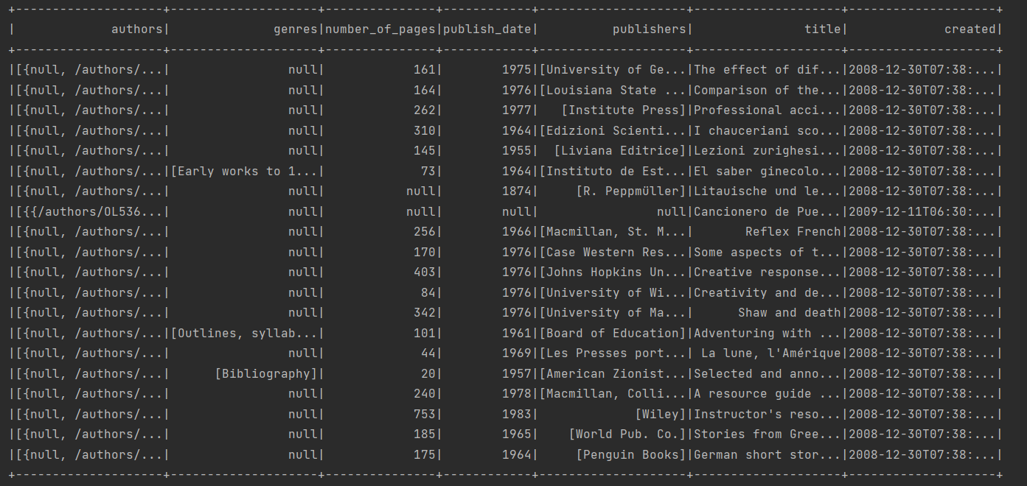
Data Profiling
Dataset size: 140 MB
FileName: ol_cdump.json
Total number of rows in the dataset: 148163
Total number of fields in the dataset: 76
Key Data fields:
Authors
Genres
Number_of_Pages
Publish_Date
Publishers
Title
Created

Slide 12
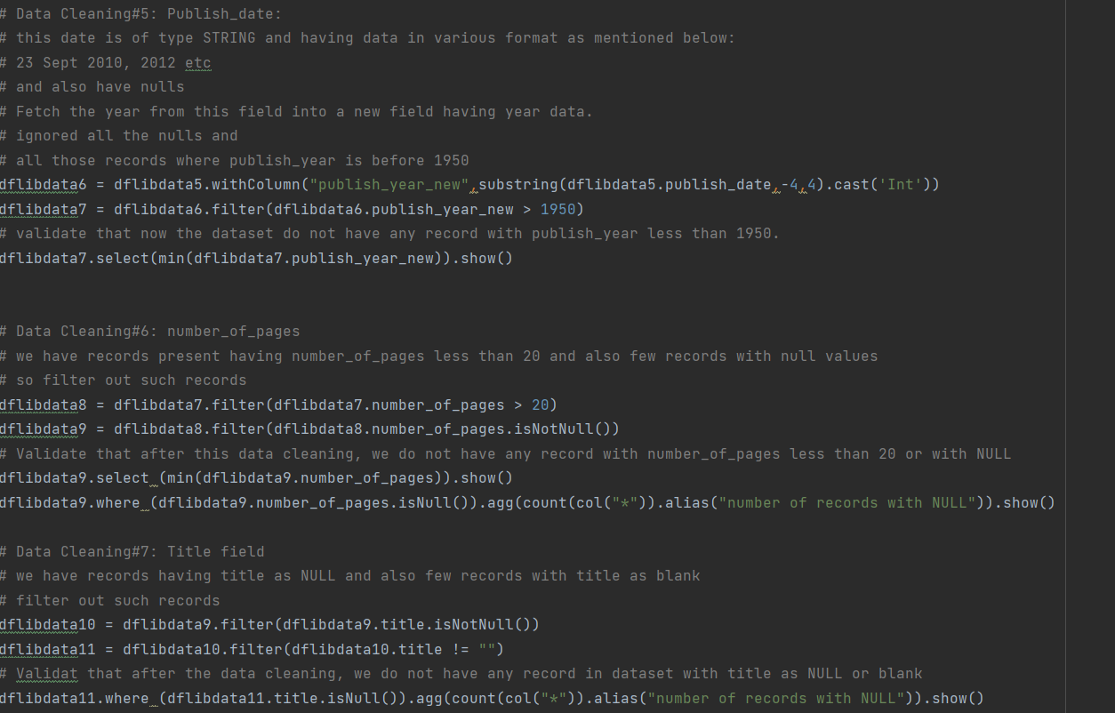
Data Cleaning
Excluded records having book title as Null or blank
Excluded records where publish_date is less than 1950 or NULL.
Excluded records where number_of_pages are less than 20 or NULL
Genres array field, exploded into multiple rows

Slide 13
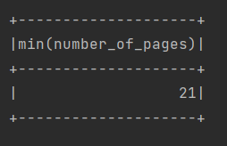
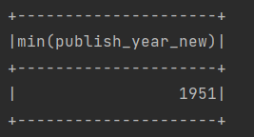
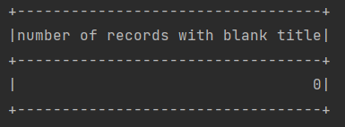
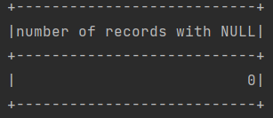
Data validation after cleaning
Minimum publish year : 1951
Minimum number_of_pages : 21
No record with Book title as blank or NULL

Slide 14
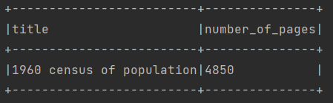
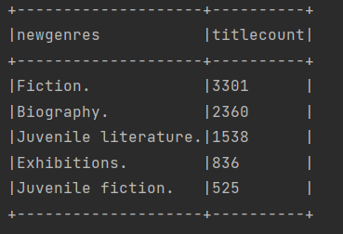
Task Result from PyCharm
Task#1 Get the book with the most pages
Task#2: Find the top 5 genres with most books

Slide 15
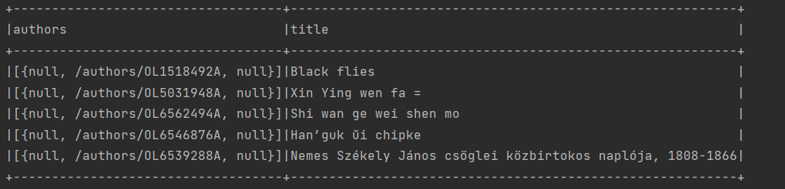
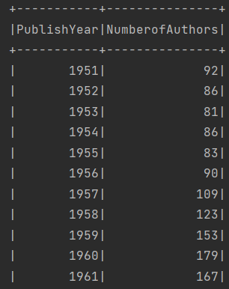
Task Result from PyCharm
Task#3: Retrieve the top 5 authors who (co-)authored the most books.
Task#4: Per publish year, get the number of authors that published at least one book.

Slide 16
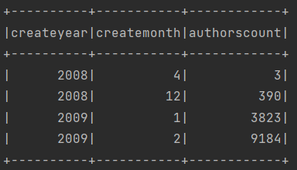
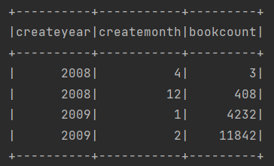
Task Result from PyCharm
Task#5: Find the number of authors and number of books published per month for years between 1950 and 1970

Slide 17
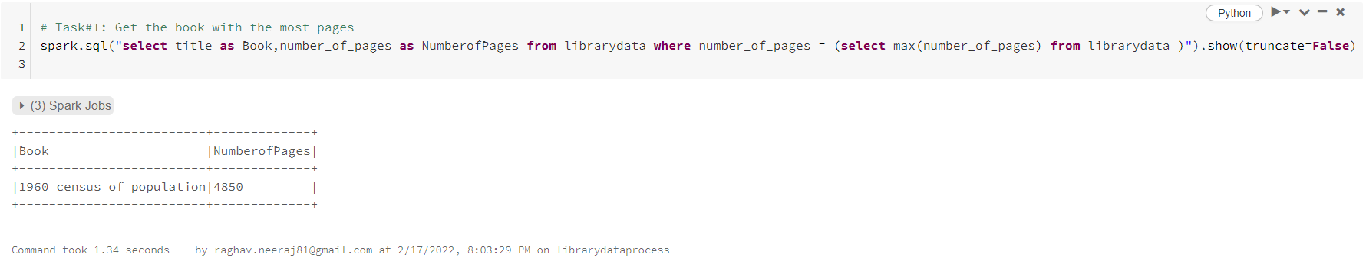
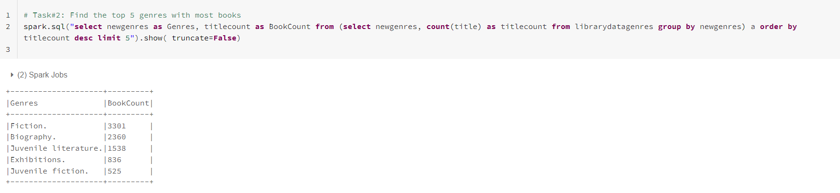
Task result from DataBricks running on AWS cloud
Task#1:
Task#2:

Slide 18
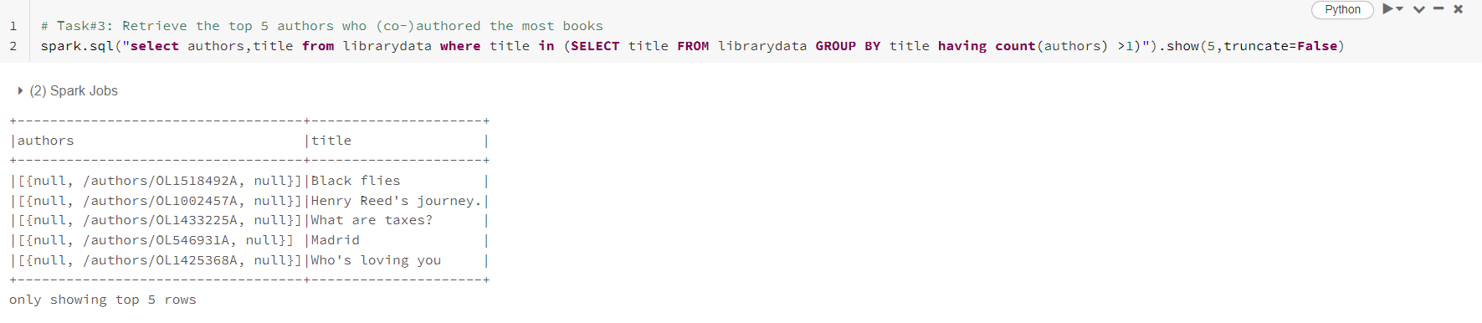
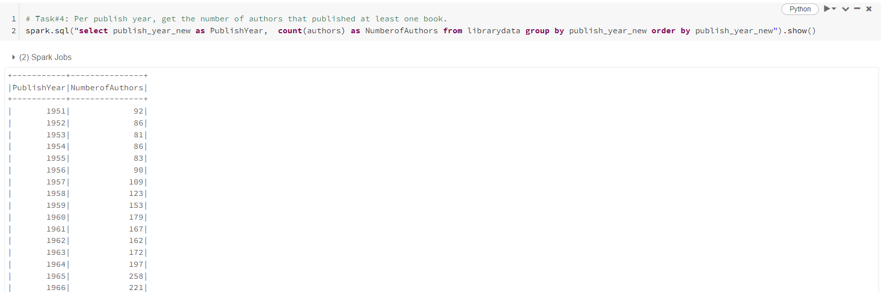
Task result from DataBricks running on AWS cloud
Task#3:
Task#4:

Slide 19
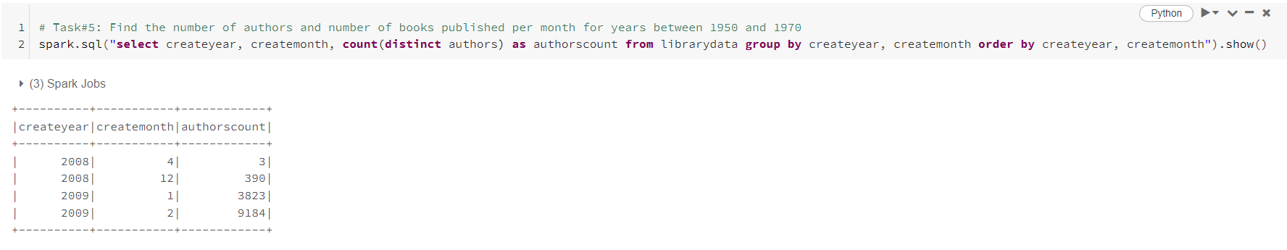
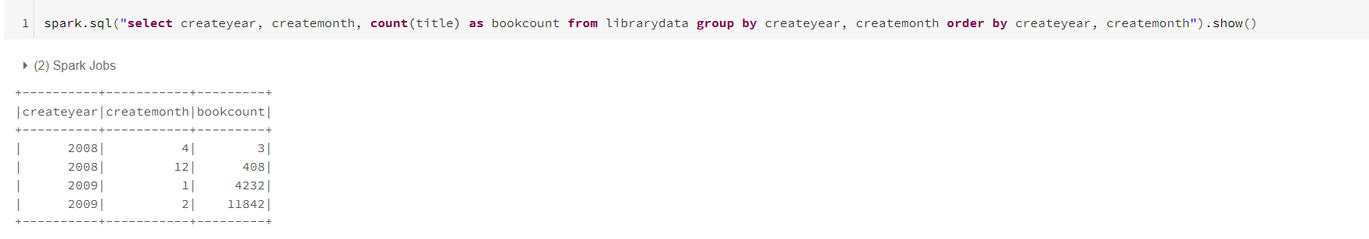
Task result from DataBricks running on AWS cloud
Task#5

Slide 20
Overall Solution Design Approach
Completed
Automate the complete data pipeline
Visualization/ Analyze
Load data
Derive business metrics and transformations
Data Preparation & Cleaning
Exploratory Data Analysis- Data Understanding
Data ingestion
Building data analysis strategy/Architecture Blueprint

Slide 21
Pipeline Testing Approach
Unit Testing by notebook parametrization
Pytest to develop the unit test cases and run on Databricks cluster using Databricks connect feature
Orchestrate data pipeline using Airflow for end-to-end integration testing
Integrate Databricks with GitHub for code repository

Slide 22
Handling Data Merge
DataBricks Delta Lake:
Databricks Delta Lake concept is to handle the CRUD operation on data.
Implemented Delta lake to maintain data layers (STG, TRANS, PUB) . So, we will handle UPSERT operations using Merge property of Delta Lake.
Automatic Schema Validation
Schema evaluation to accommodate new columns
We can also implement SCD in Delta Lake
Delta Lake support ACID property

Slide 23
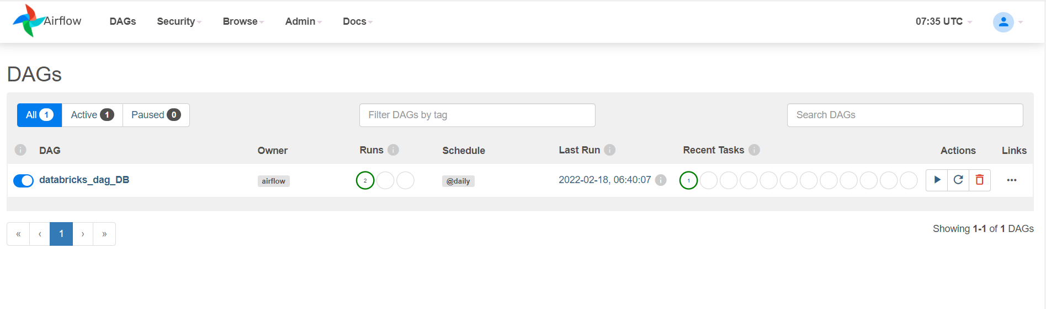
Data Pipeline Orchestration- Airflow

Slide 24
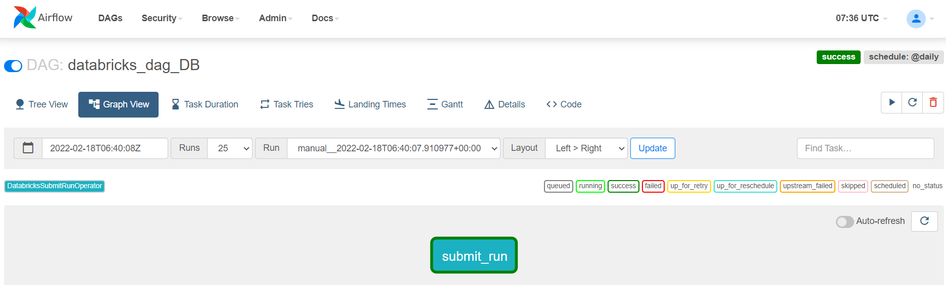
Data Pipeline Orchestration- Airflow

Slide 25
Thank You!

